Slide 1
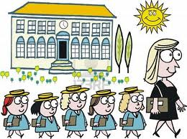
WELCOME TO CLASS 4
ENGLISH LESSON
Miss Ngan

Slide 2
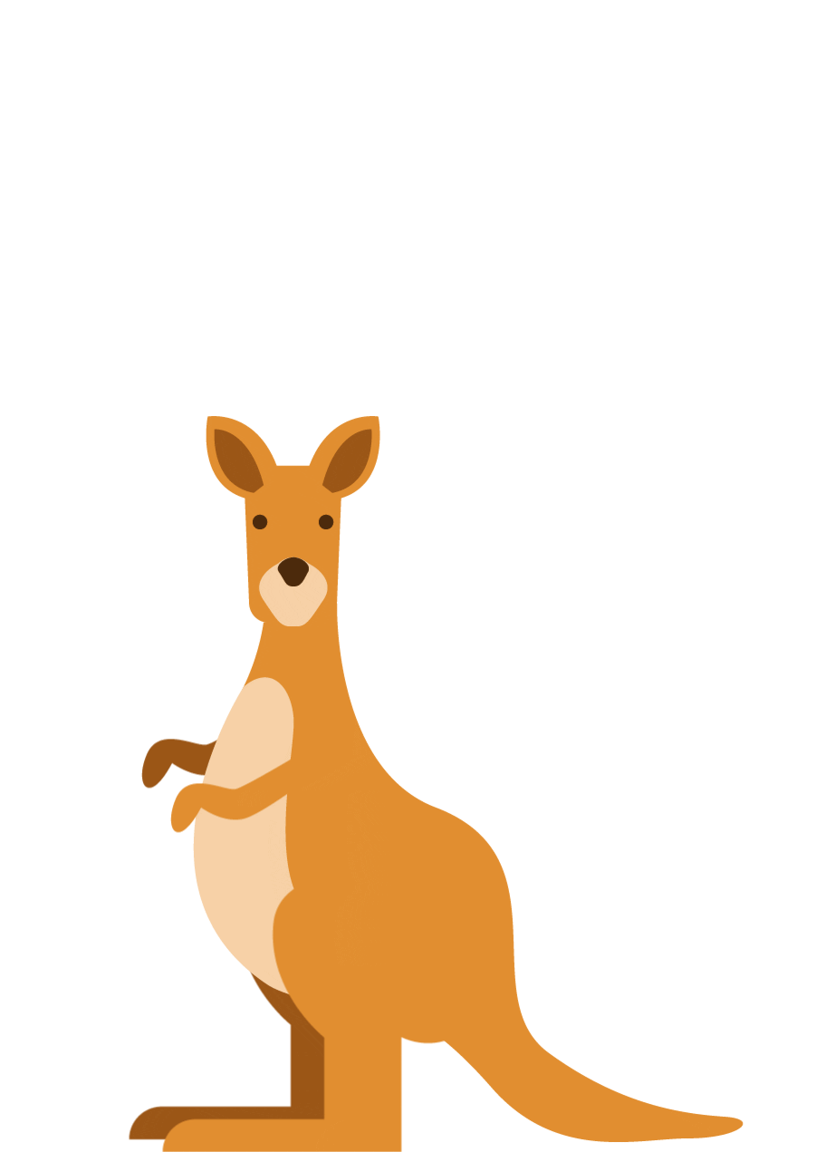
Unit 1: They’re from Australia
Monday, Octorber 4th, 2021
(LESSON 4 – 6)

Slide 5
1 Listen, point, and repeat

Slide 6
crayon

Slide 7
brush

Slide 8
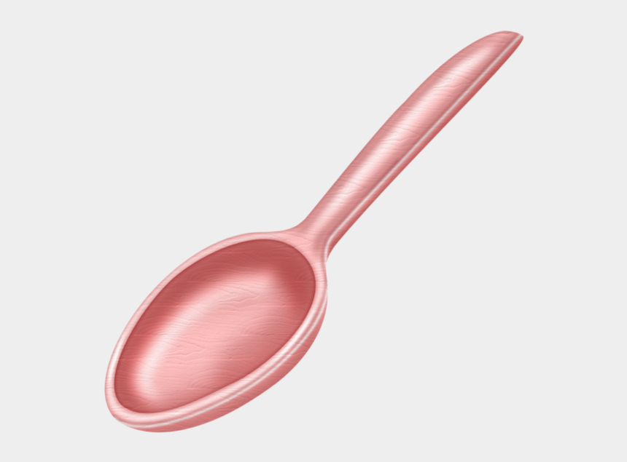
spoon

Slide 9
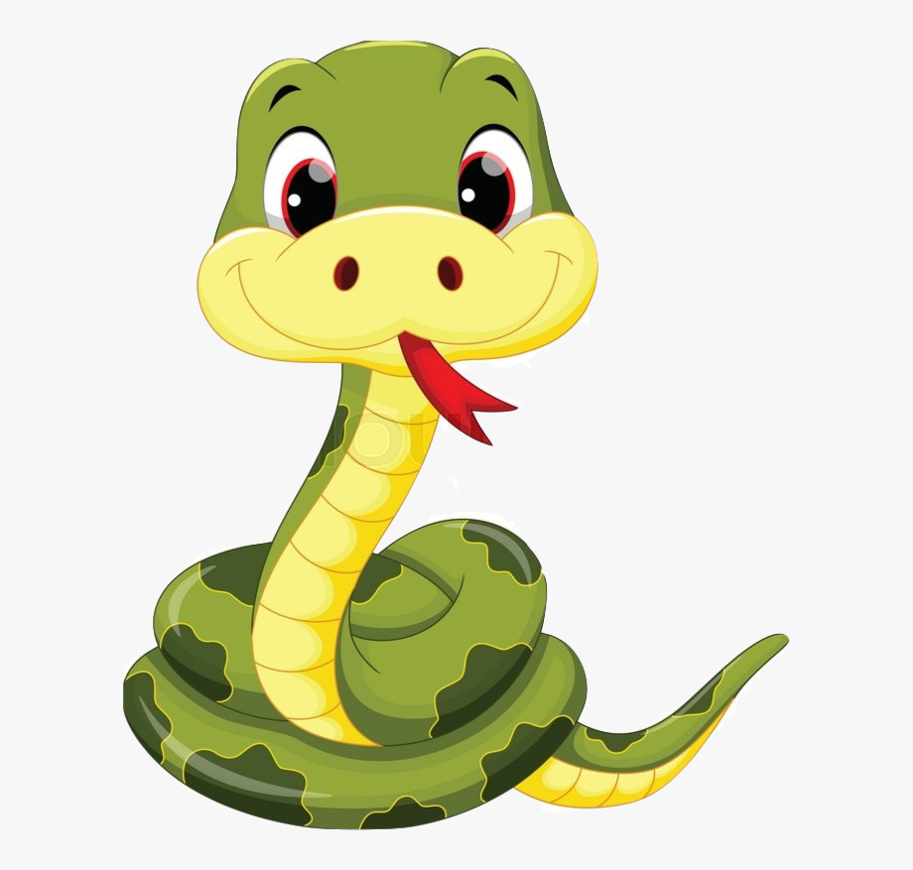
snake

Slide 10
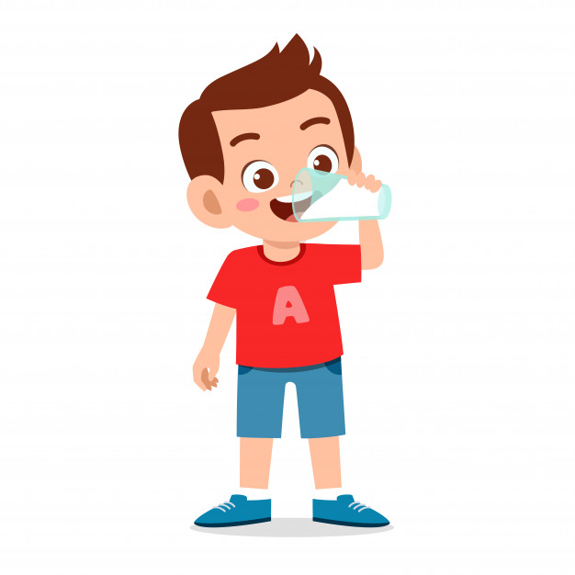
drink

Slide 11
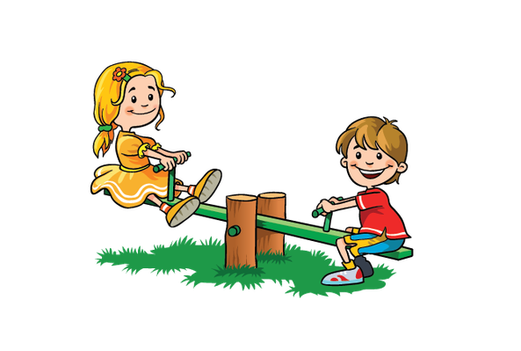
play

Slide 12
crayon

Slide 13
brush

Slide 14
spoon

Slide 15
snake

Slide 16
drink

Slide 17
play

Slide 18
word
GAME
Choose the right option.

Slide 19
GREAT
snake
drink
play

Slide 20
GREAT
snake
crayon
spoon

Slide 21
GREAT
drink
brush
play

Slide 22
GREAT
spoon
crayon
play

Slide 23
GREAT
drink
brush
snake

Slide 24
GREAT
spoon
drink
snake

Slide 25
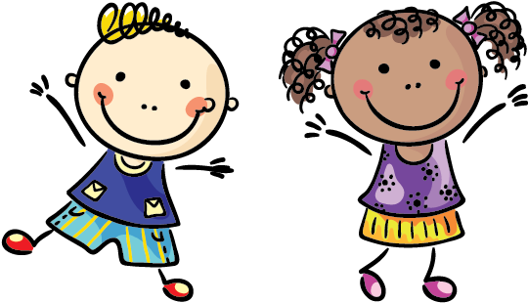
Good job.

Slide 26
Listen and point

Slide 27
2. LISTEN and CHANT

Slide 28
3. Read the chant again. Circle the words from 1.

Slide 29
4. Circle the beginning letters. Listen and check.

Slide 30
Workbook time! Page: 11

Slide 32
1. Listen,point, and repeat.

Slide 33
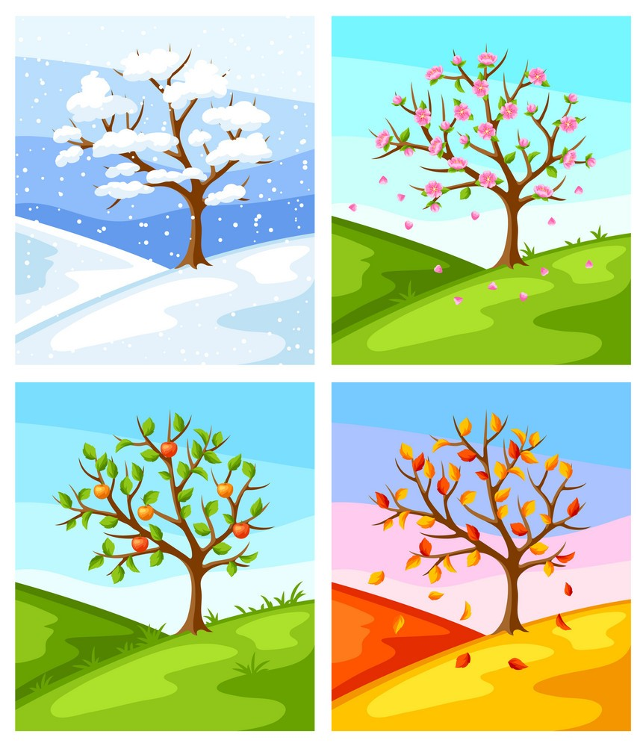
SEASONS

Slide 34
spring

Slide 35
summer

Slide 36
fall

Slide 37
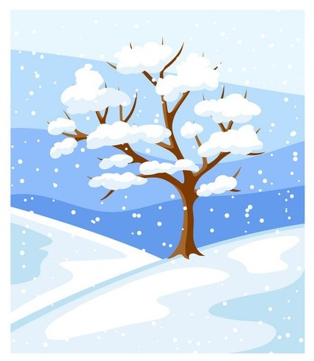
winter

Slide 38
spring

Slide 39
summer

Slide 40
fall

Slide 41
winter

Slide 42
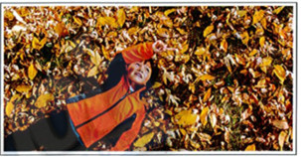
2. Look at the pictures below. What are they wearing?

Slide 43
3. Listen and point

Slide 45
Read again and write 'a' or 'b’ a. Ho Chi Minh City b. Ha Noi
1. There are four seasons. _b_ | 2. In the spring, the trees and plants grow.___
3. In the rainy season, it rains a lot. ___ | 4. People eat hot noodle soup to keep warm. ___
5. The rain comes very fast. ____ | 6. The weather is warm all year round. ___
b
a
b
a
a

Slide 46
Workbook time!!! Page 12

Slide 48
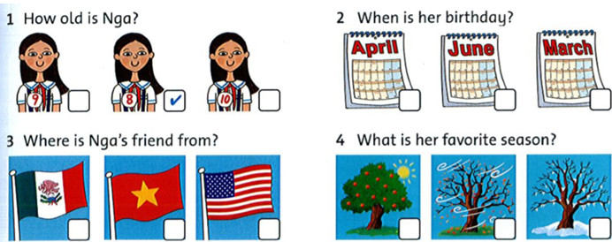
Listen and check (✓).
✓
✓
✓

Slide 49
Speaking
Ask and answer about you.
How old are
you?
PAIRWORK
2. Where are
you from?
3. What's your
favorite
season?

Slide 50
Do you know that......???

Slide 51
Task: Write sentences about your classmates.
Example:
Bao is nine. His birthday is in April.
1. _______________________________
2. ________________________________
3. ________________________________
4. ________________________________

Slide 52
Workbook time!!! Page 13

Slide 53
The bye bye song
Bye, bye.
See you tomorrow.
Bye, bye.
See you tomorrow.
Bye, bye.
See you tomorrow.
Bye, bye. Bye, bye.
The bye bye
song

